Slide 1
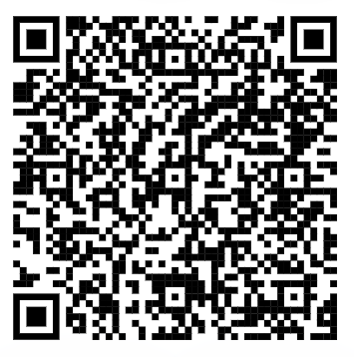
PowerApps – Robotic Process Automation
https://tinyurl.com/4x5snew4
https://github.com/alanchow85/RPA
Notes:
Install Power Automate - Power Automate | Microsoft Learn

Slide 2
PowerApps – RPA with Email and Form Automation

Slide 3
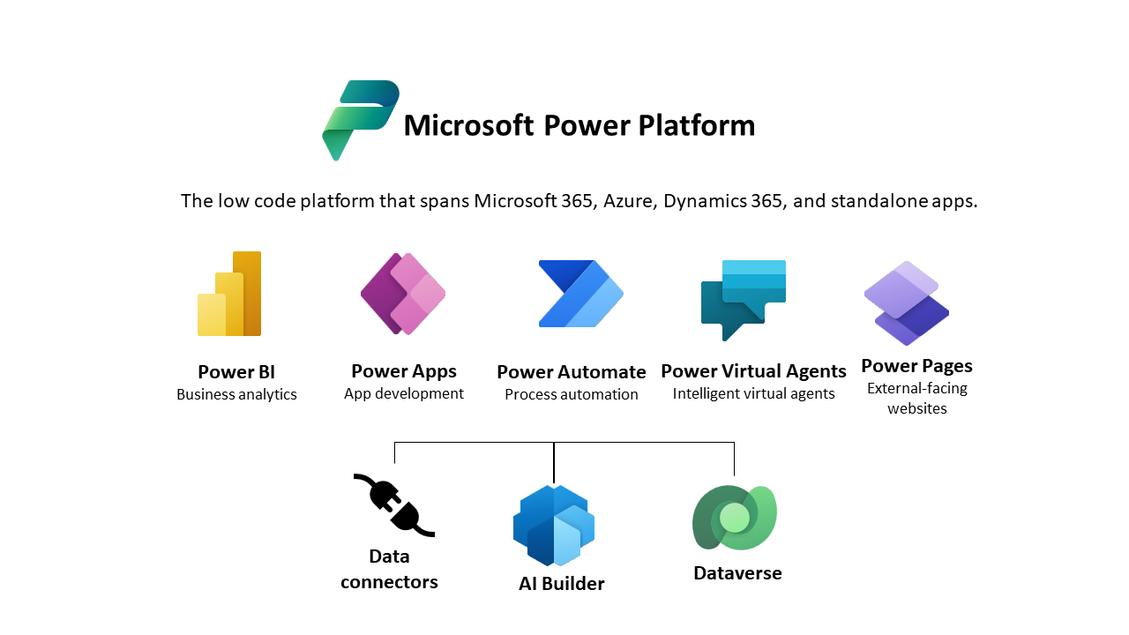

Slide 4

PowerApps – Robotic Process Automation
Setup Outlook
UI Automation & Email Automation
Data Entry Automation
Data Extraction from FormSG email

Slide 5
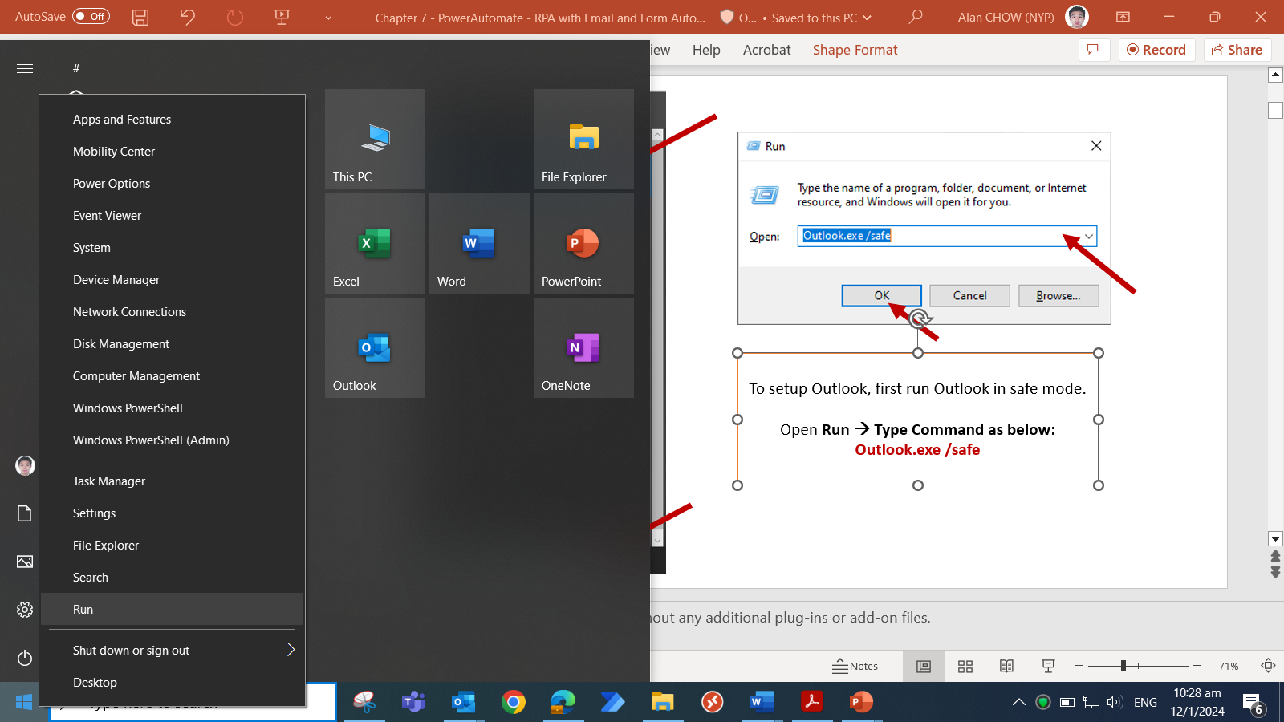
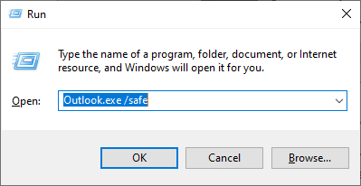
3) → Type Command as below:
Outlook.exe /safe
4) Click ok
2) To setup Outlook, first run Outlook in safe mode.
click on Run
1) Left Click on the windows, and right to show up the run button
Notes:
safe mode is a way to load application with outlook without any additional plug-ins or add-on files.

Slide 6
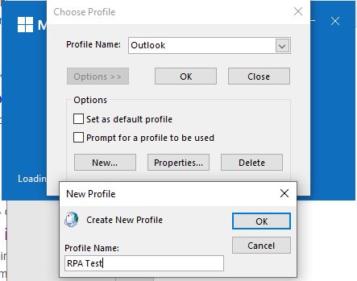
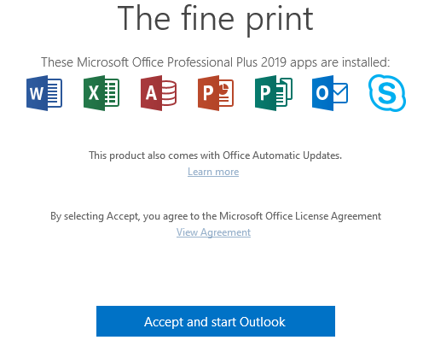
Create a new profile by:
Click Options → New…→
Type Profile Name to be RPA Test
→ OK

Slide 7
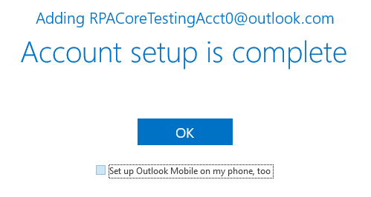
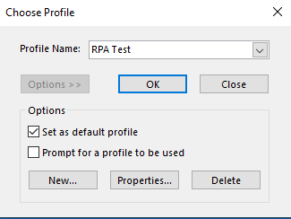
In email screen, type in your email and click login.
In the password panel, enter your outlook email
Password.
Uncheck Set Up mobile
Select RPA Test as profile→ check Set as Default Prompt → Ok.
Outlook set up is complete.

Slide 8
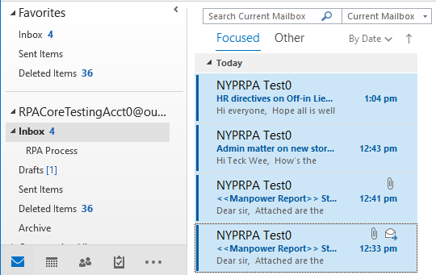
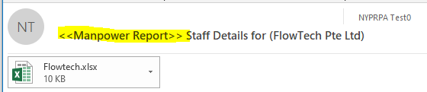
Drag in the sample email files into outlook inbox.
2 of the emails are Manpower Reports.
Each report has a specific subject and an attachment.
For these types of automation, it is important to involve stakeholders and ensure that they are adhering to certain data format, example:
<<Manpower Report>>

Slide 9
PowerApps – Robotic Process Automation
Setup Outlook
UI Automation & Email Automation
Data Entry Automation
Data Extraction from FormSG email

Slide 10
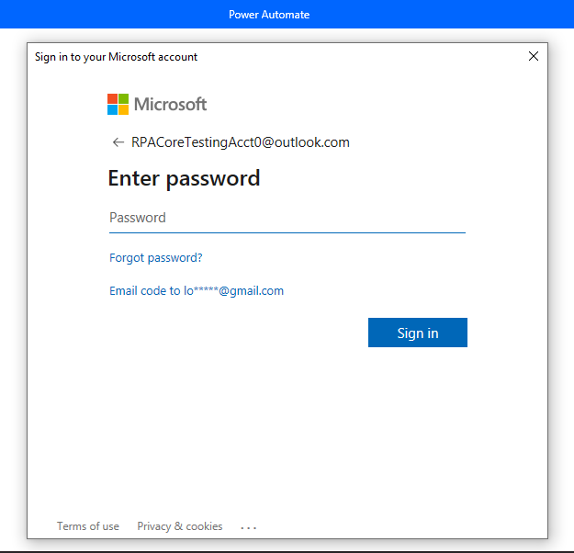
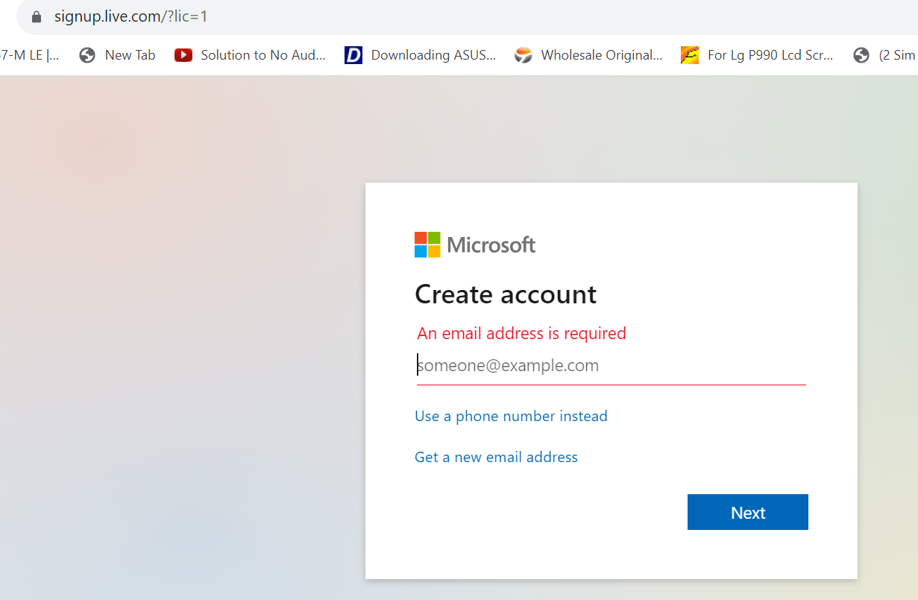
Open Power Automate desktop and log in using your outlook account created. You can also sign in with your Github account
If not, sign up at signup.live.com

Slide 11
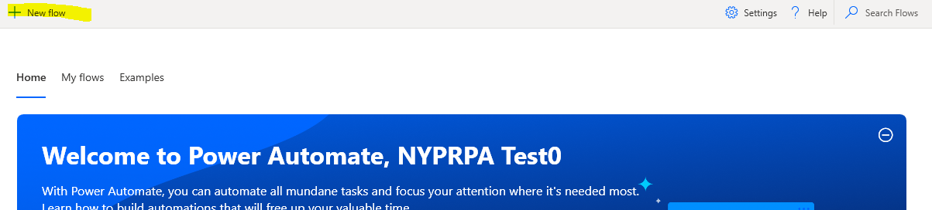
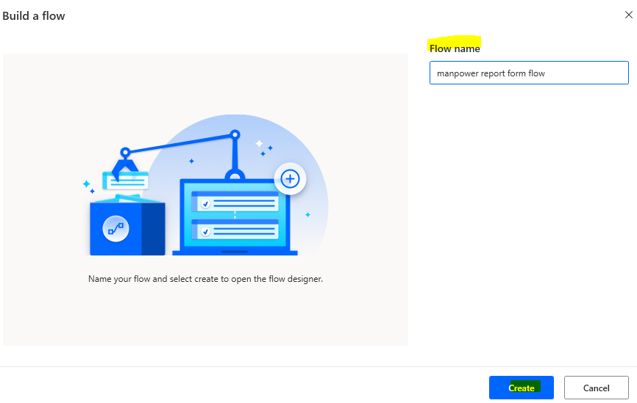
Create a new flow:
+New Flow→ Flow Name→ Create
Unicorn Name
Unicorn Name

Slide 12
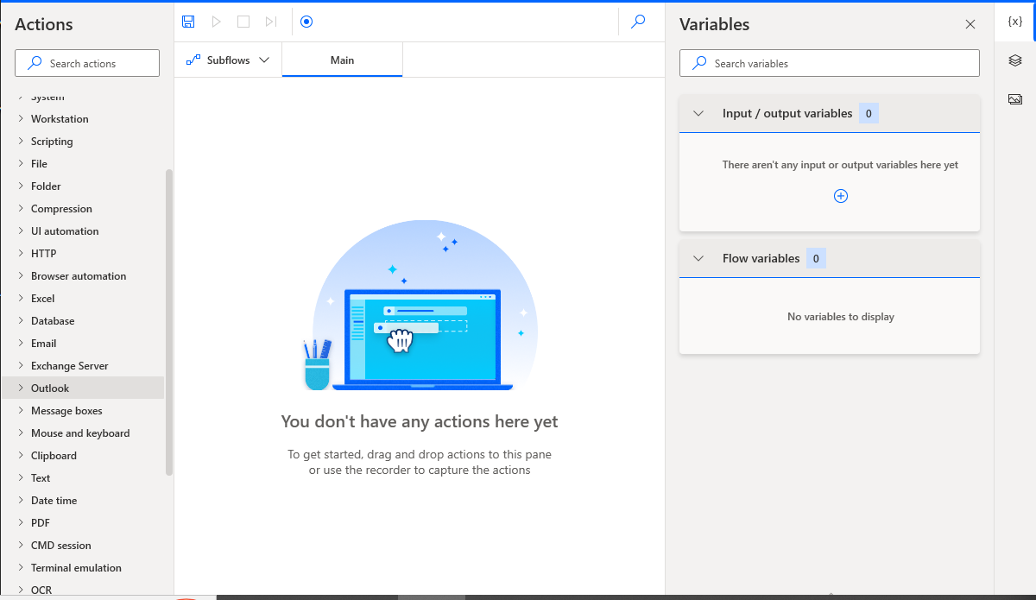
Drag and drop your actions here to create a sequence/flow
For data that you want to reuse
For all the actions that can be done.
Search bar is important

Slide 13
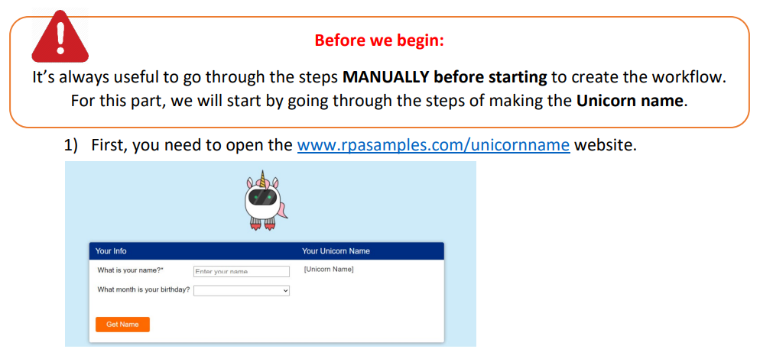
Unicorn Name – Your first robot!
www.rpasamples.com/unicornname

Slide 14
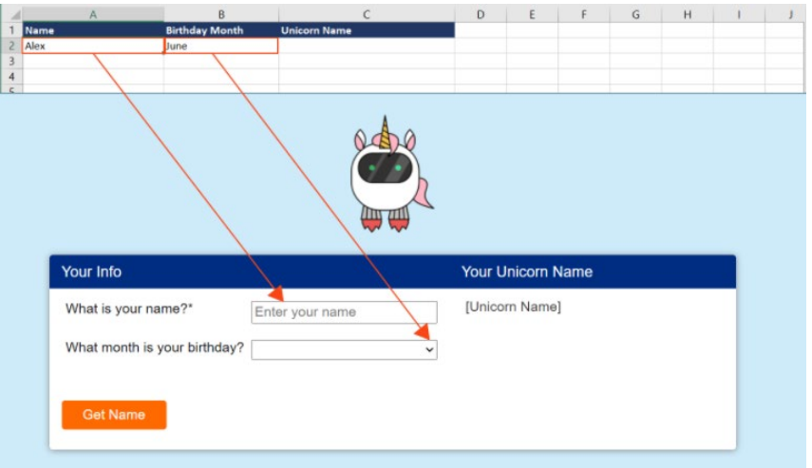
2) Open Unicorn name excel sheet. Notice that it contains a name and a month. These are fields to add to the form.
3) After click get name, we then copy the name back into the excel sheet.

Slide 15
Now that we know the steps:
We will now create the actual flow in PowerAutomate desktop.

Slide 16
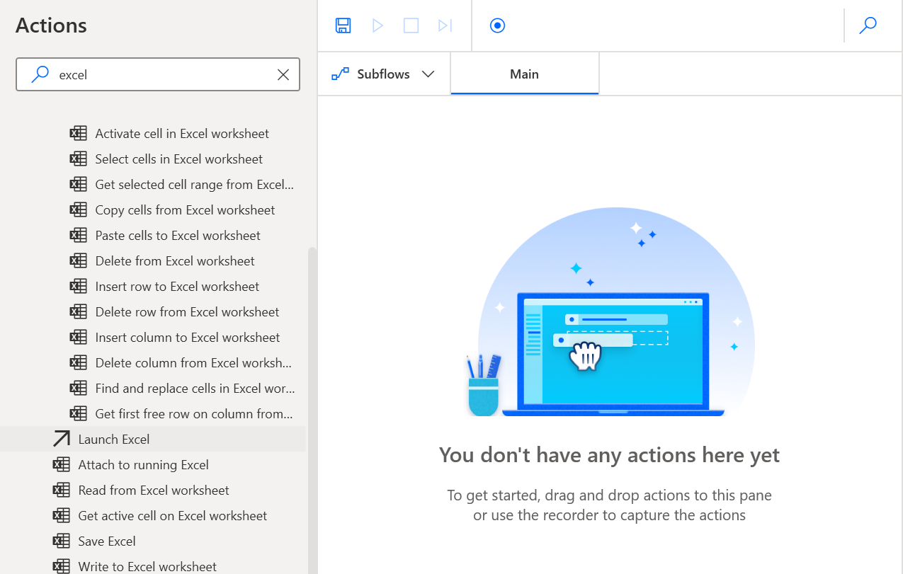
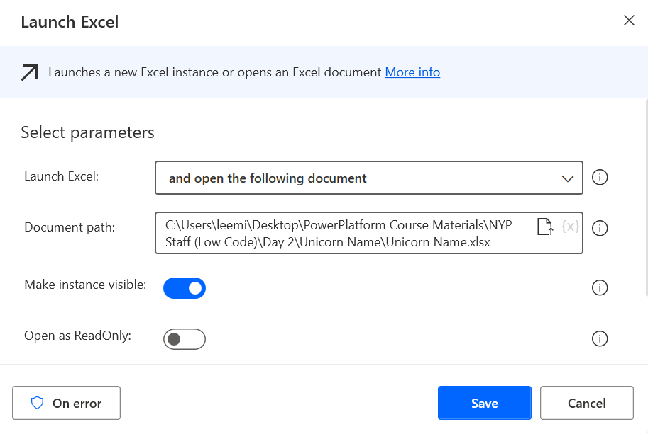
Drag and drop Launch Excel action.
Make sure you open the unicorn name excel file by opening the following document option browsing to the excel file.

Slide 17
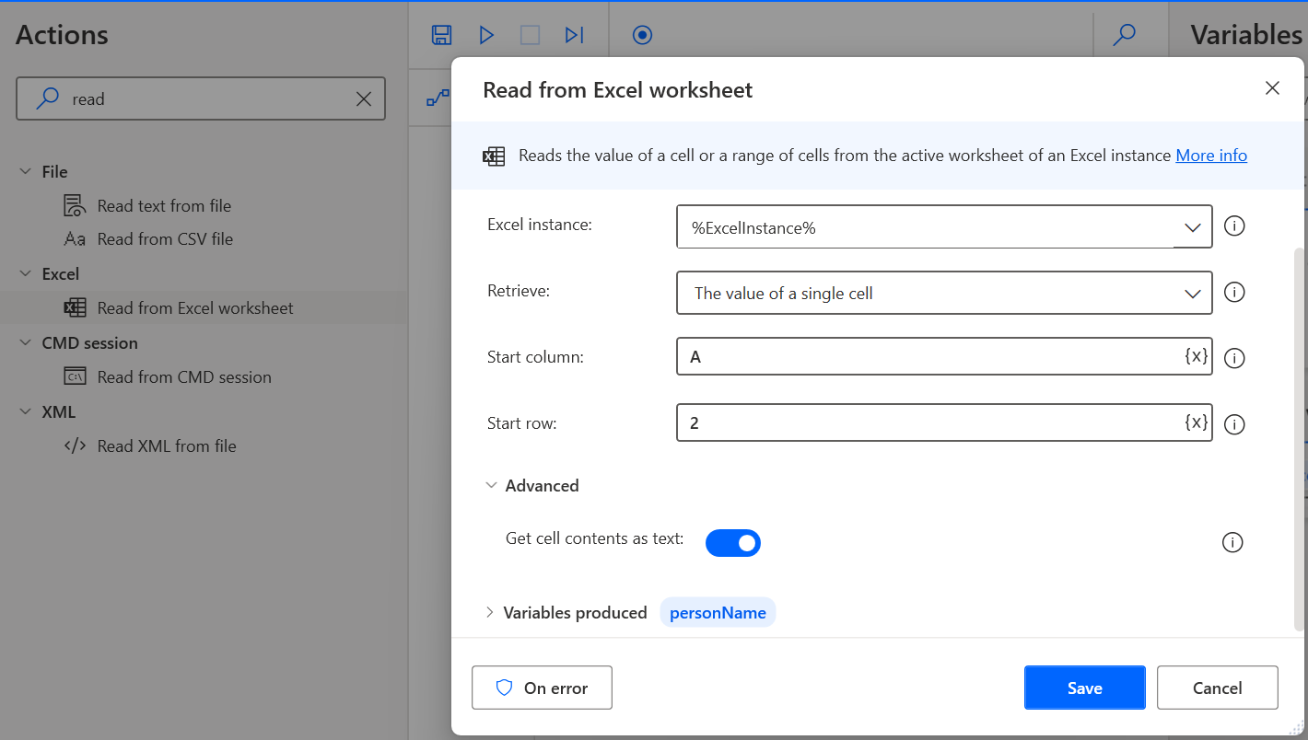
Drag and drop Read form Excel worksheet action.
Put values as A and 2 to read A2 cell (name).
Click on advanced
Enable the get cell content as text
Update the Variable name to personName, so we can reference easily later.

Slide 18
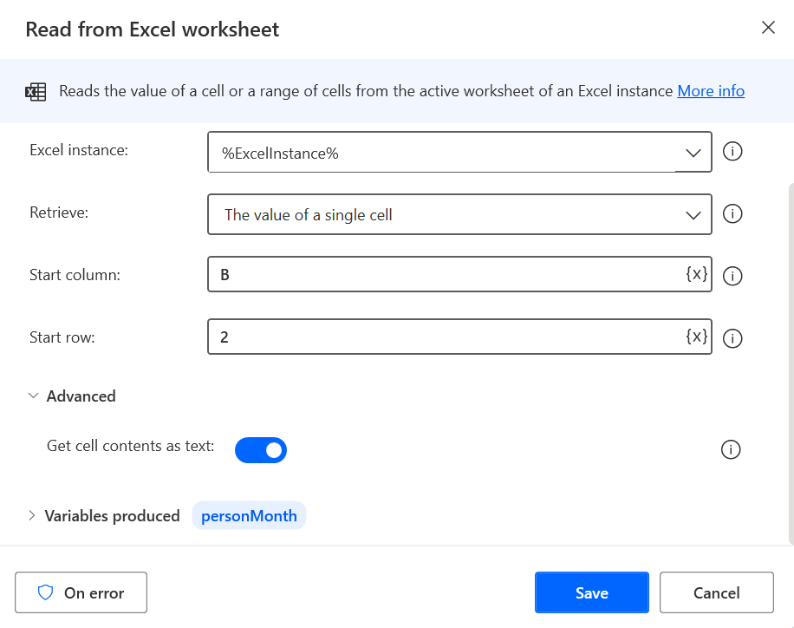
Drag and drop Read form Excel worksheet action again.
Put values as B and 2 to read B2 cell (Birthday month).
Update the Variable name to personMonth, so we can reference easily later.

Slide 19
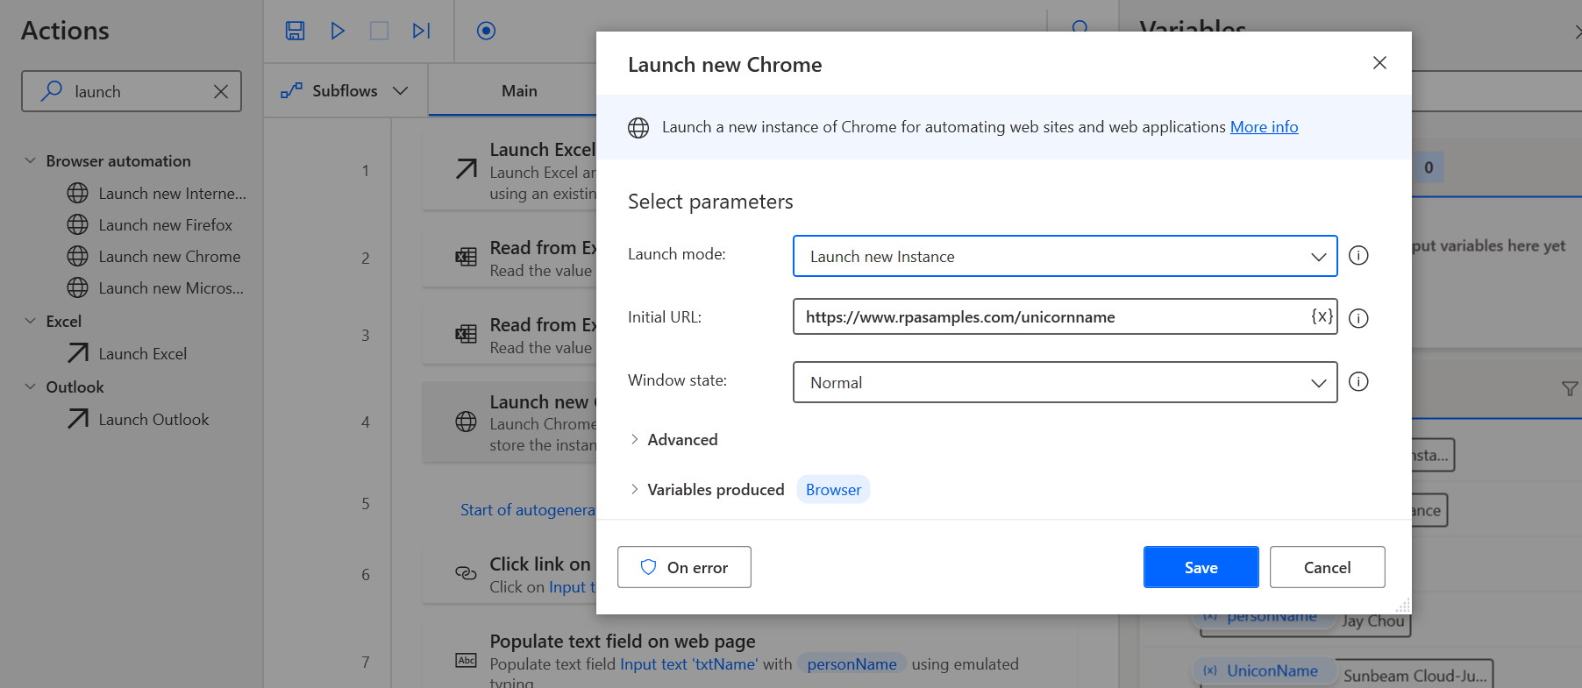
Key in the site address: www.rpasamples.com/unicornname
Drag and drop Launch new Chrome

Slide 20
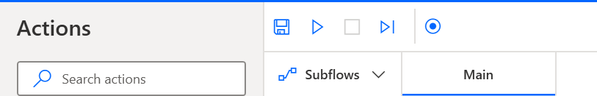
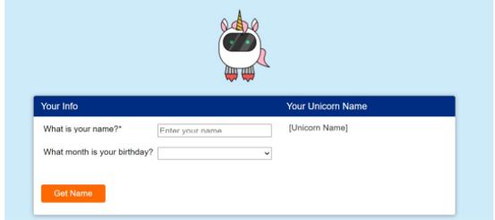
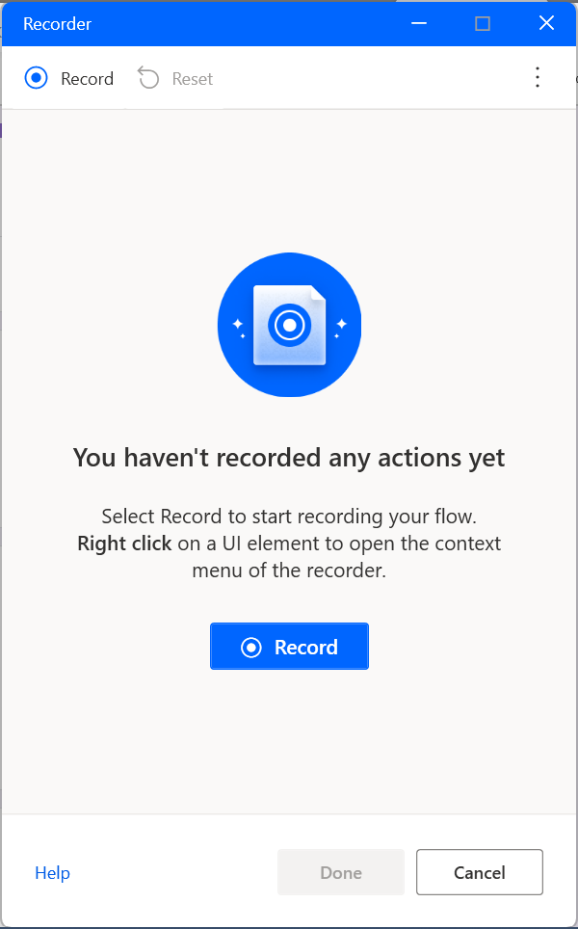
To start Form Automation, begin by opening the Form in Edge browser
The record button allows you to record every step in filling up the form.

Slide 21
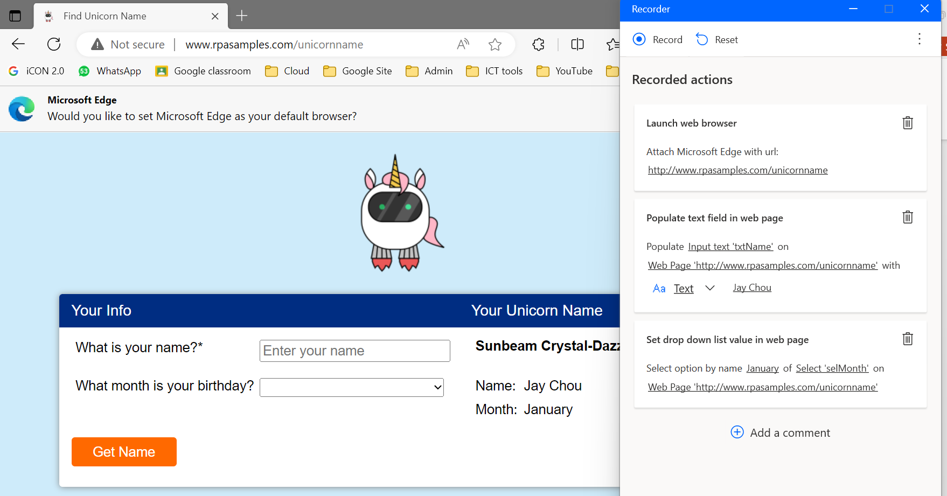
After you click Record, you will notice that you can start to click on the textbox. Key in “jay Chou” or any test data first.
Finally, click here to generate the name.
Continue to record by selecting any month.

Slide 22
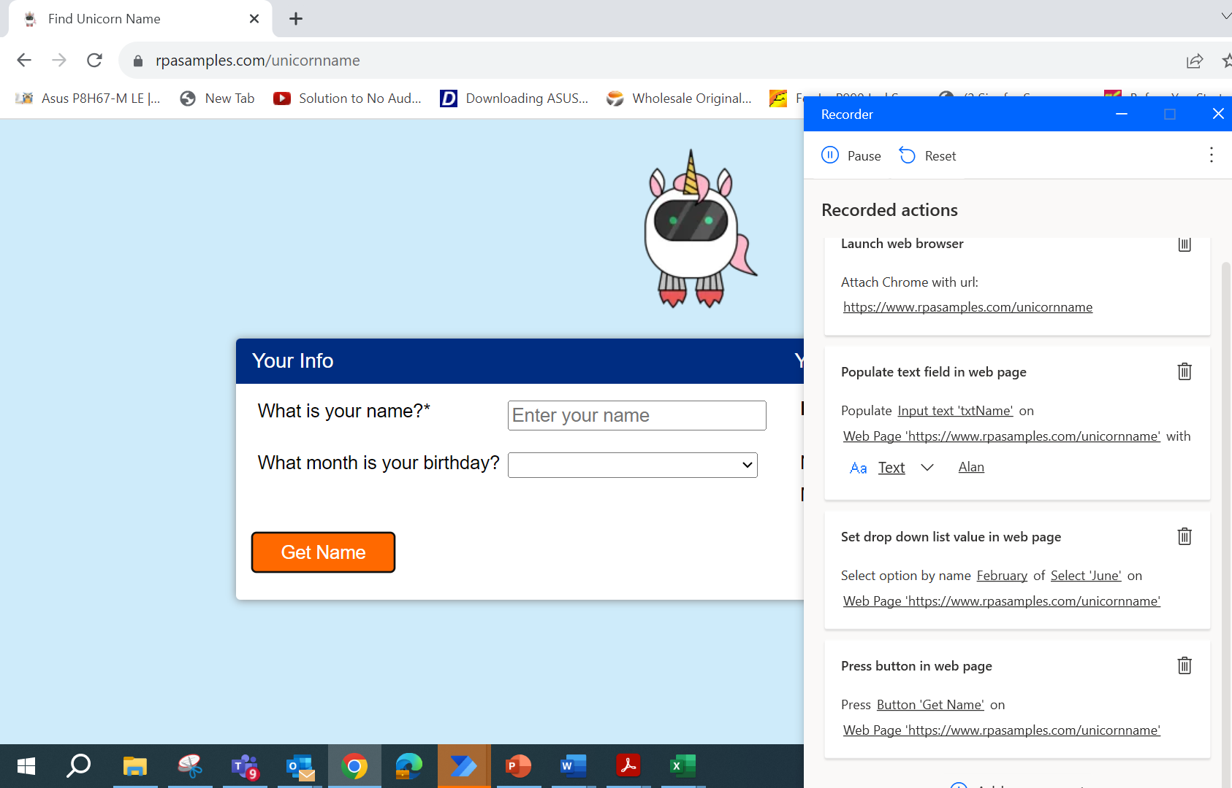
As you record, more steps are added to the sequence. Click on done at the bottom after all the steps are recorded..

Slide 23
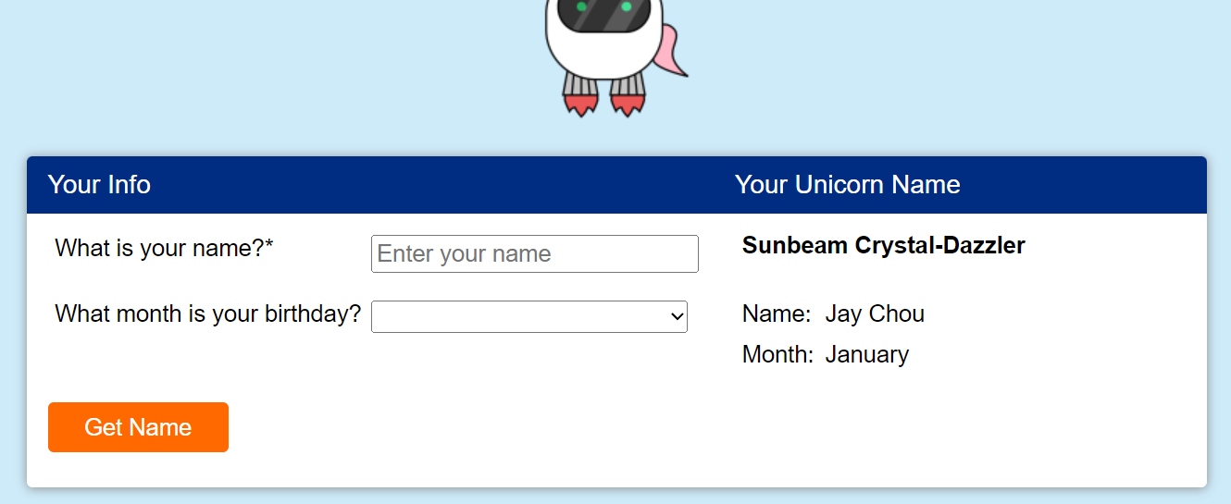
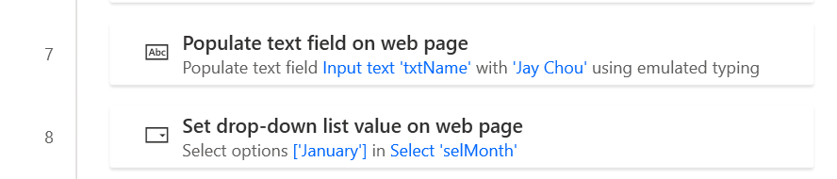
Notice that the name and month is always the same, as we hardcoded the values. It will always be what you type (e.g Jay Chou or your name). Hence, we need to change the hardcoded value to a dynamic value in a list

Slide 24
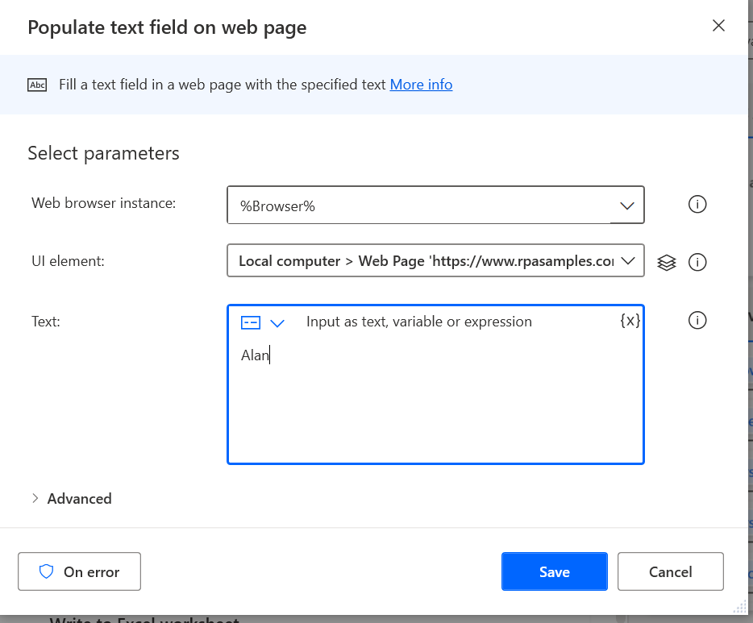
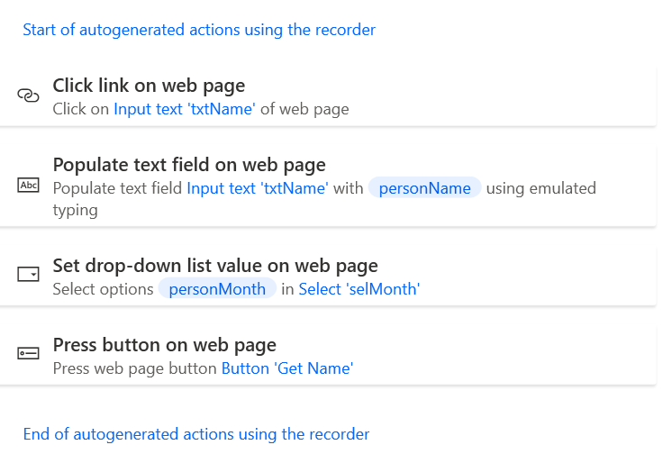
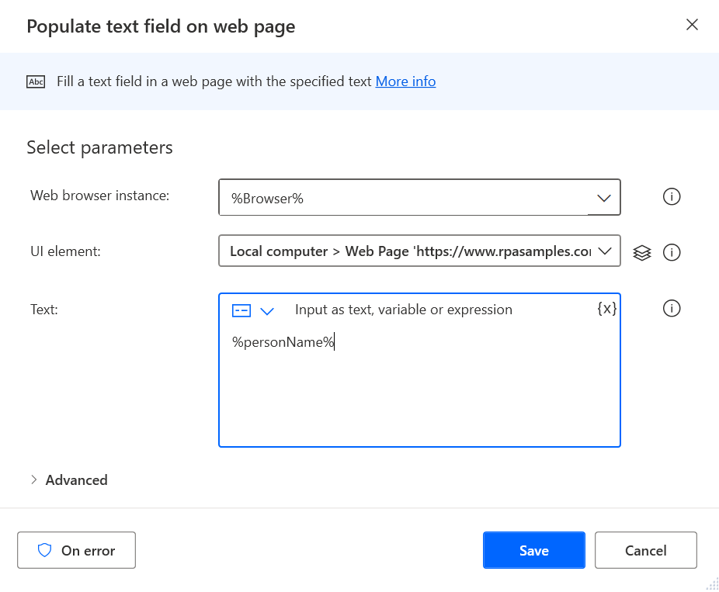
Method 1
We need to change the values from the typed value “Alan” to the variable “personName”
Note: If we want to streamline our recorded steps, we can remove the redundant clicks like “click link on web page”

Slide 25
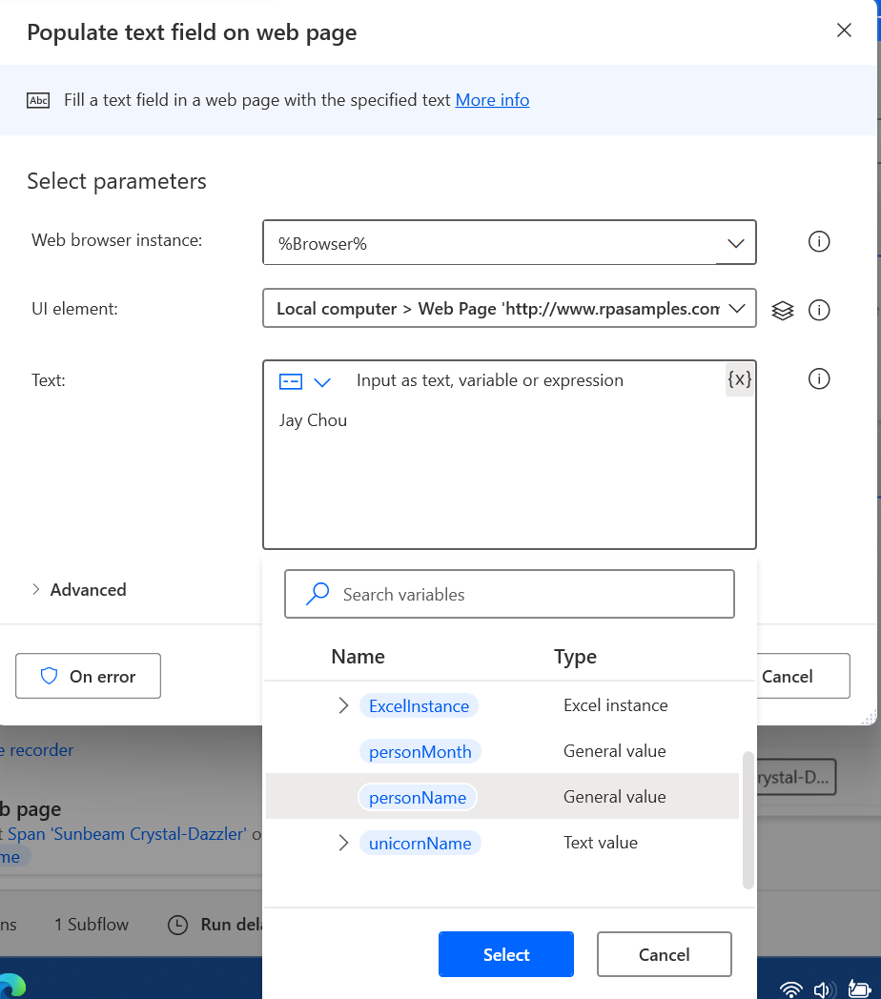
We can also change the Text from a hard coded text to the personName variable by clicking the icon “{x}”
Method 2

Slide 26
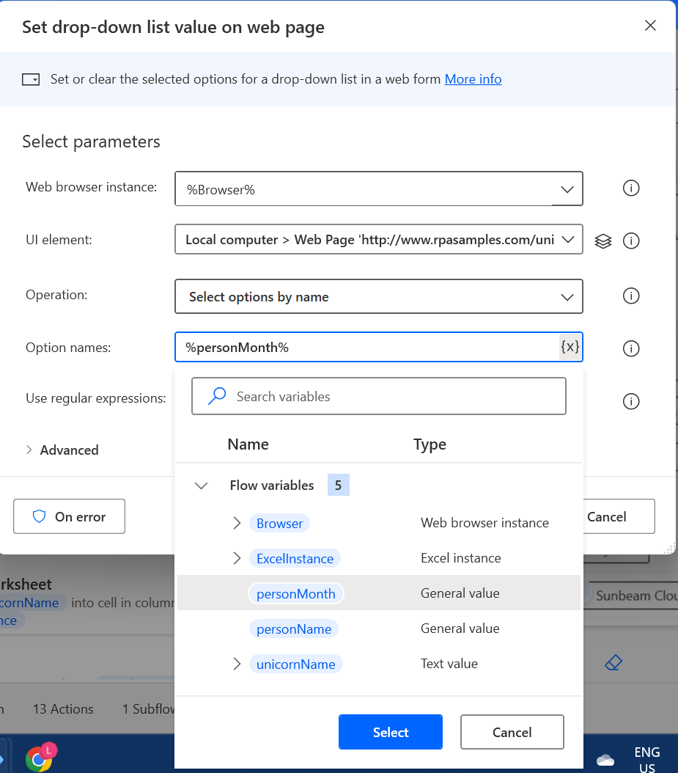
Then we select the variable created when we read the excel (e.g personMonth)
Method 2

Slide 27
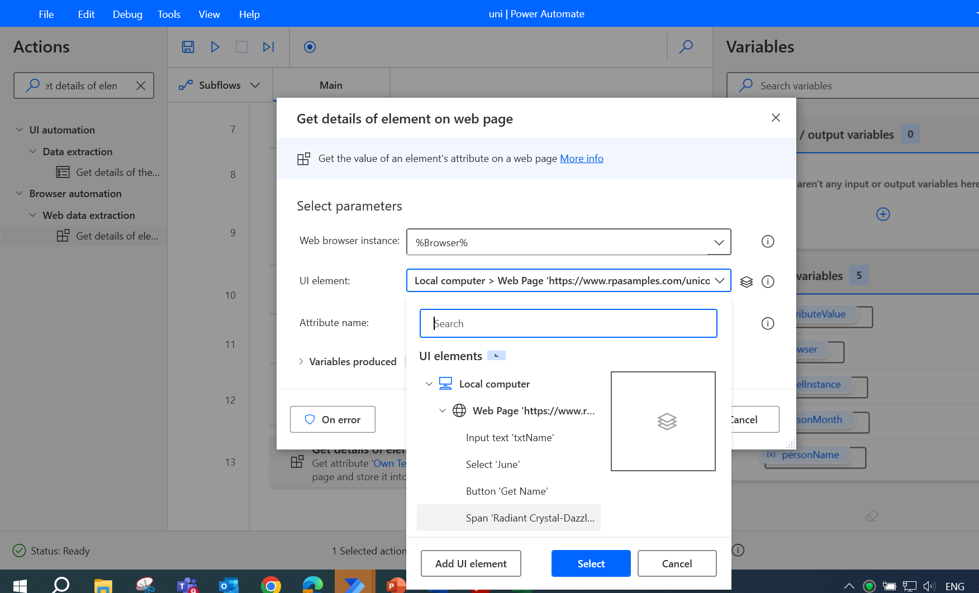
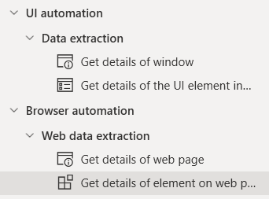
Drag the “Get Details of element on web page” to the flow.
Then add the UI element, unicorn name to extract the information.
In this case, it is “Radiant Crystal-Dazzler”

Slide 28
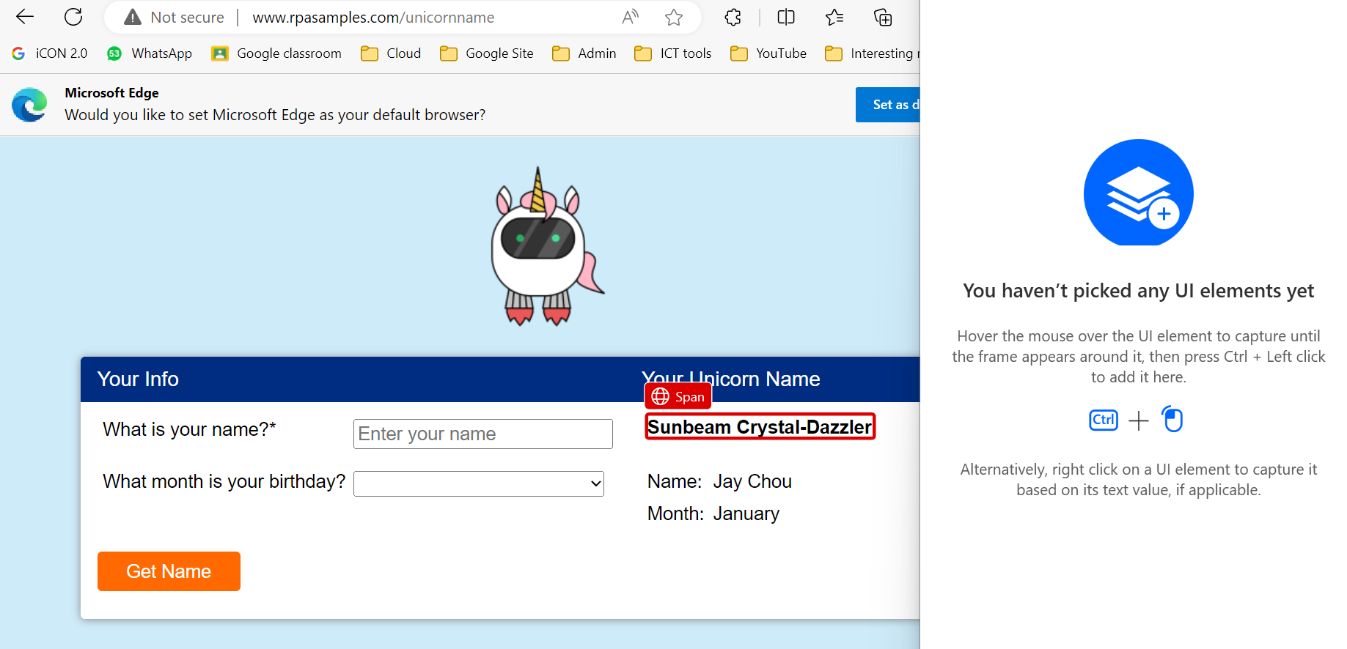
Ctrl + Select this. Then rename the variable to UnicornName in the property screen.

Slide 29
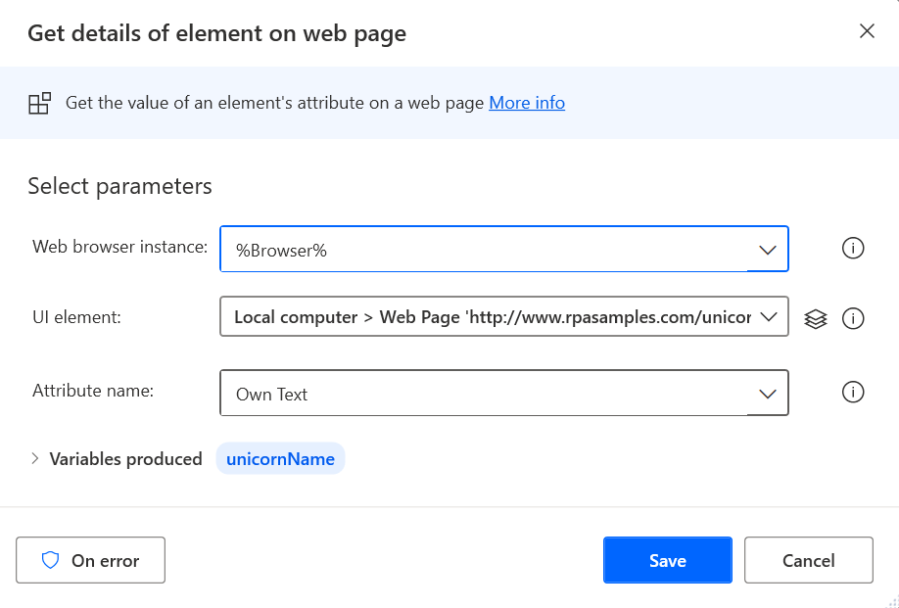
Change the variable name to unicornName.
Then click Save.
Notes:
https://www.rpasamples.com/unicorn

Slide 30
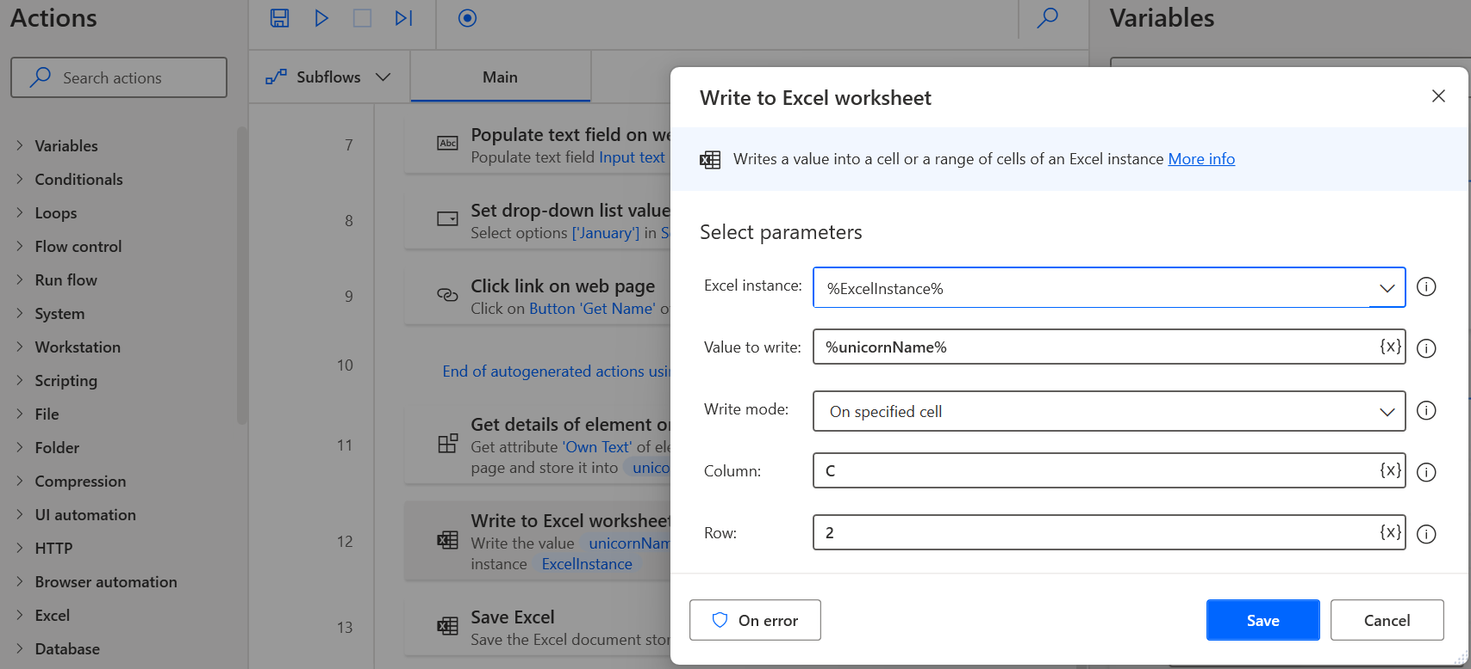
Now that we have the Unicorn name, lets write to excel file:
Drag Write to Excel Worksheet to the flow.
Put values as C and 2 to write C2 cell (Unicorn Name).

Slide 31
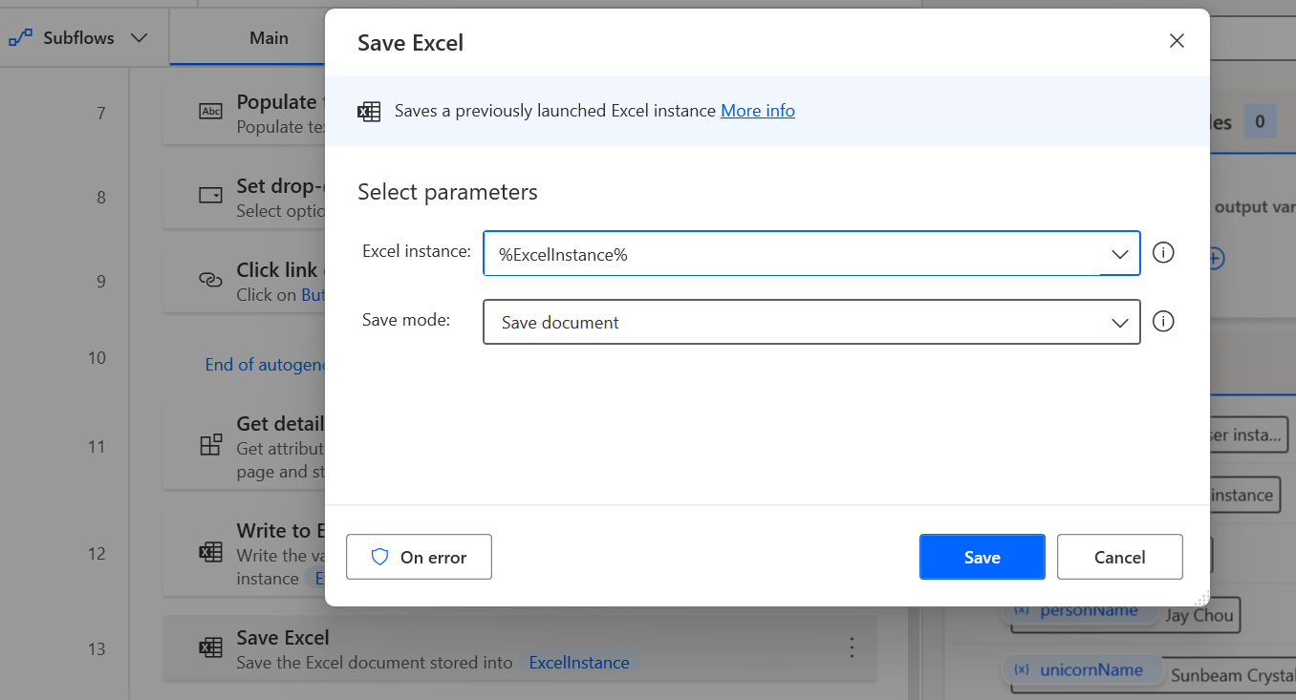
Lastly, drag the save excel function:

Slide 32
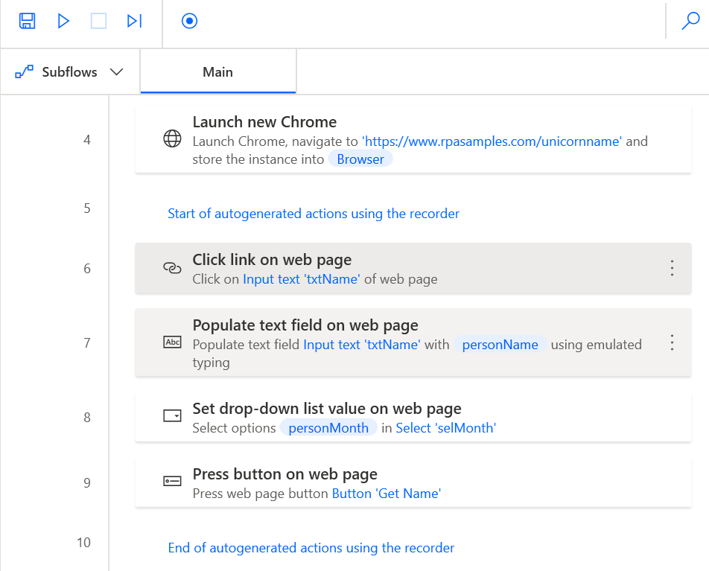
Click on run button to test the flow

Slide 33
PowerApps – Robotic Process Automation
Setup Outlook
UI Automation & Email Automation
Data Entry Automation
Data Extraction from FormSG email

Slide 34
Our workflow for Email Automation
Retrieve all emails with the <<Manpower Report>> and download attachments
Read excel files and add to google form
Reply to emails

Slide 35
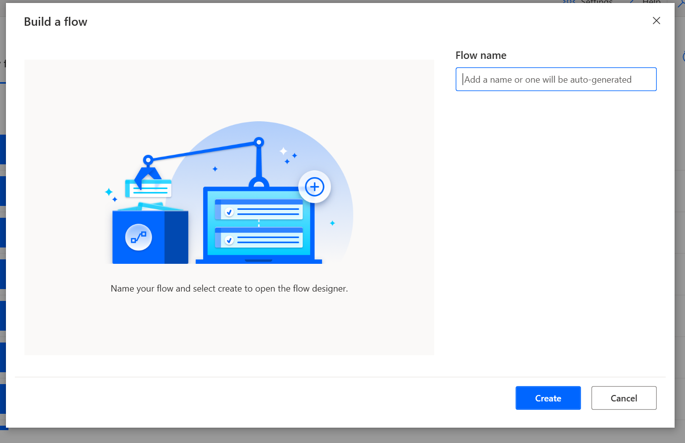
Create a new flow:
+New Flow→ Flow Name→ Create
RetrieveEmail
RetrieveEmail

Slide 36
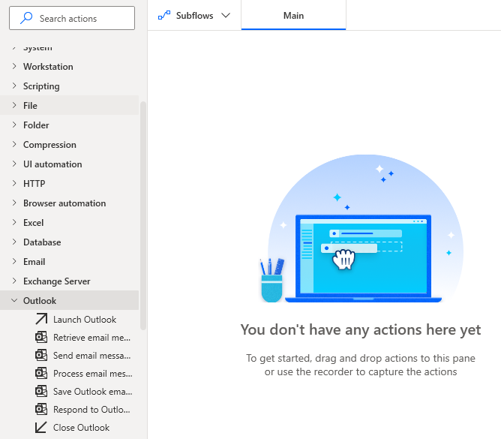
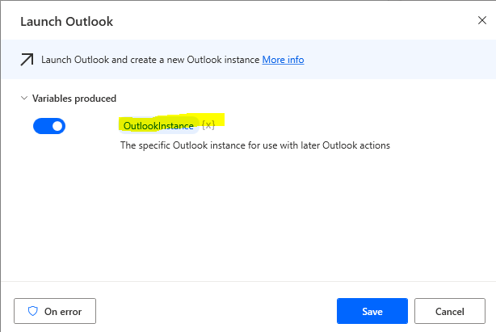
Go to Outlook→ Drag Launch Outlook to the Main Sequence
An Outlook variable will be created. It will help reference to the Outlook.

Slide 37
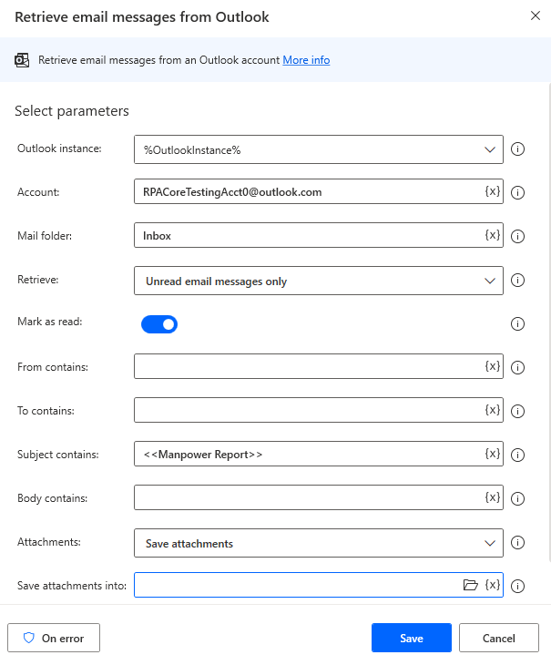
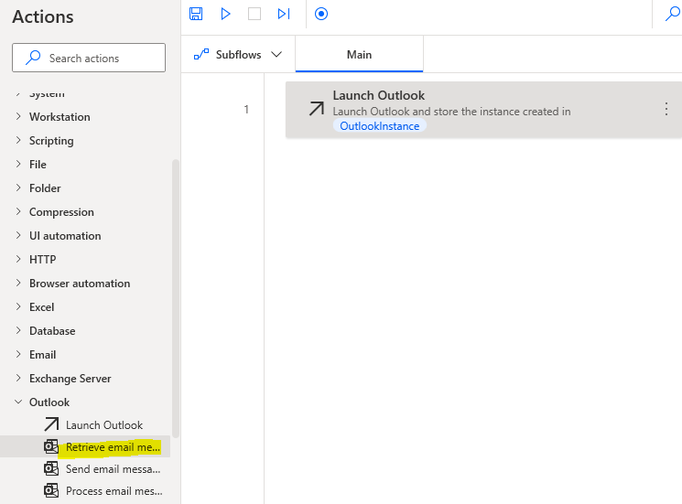
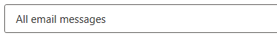
Account → Your email
Mail folder→ Inbox
Retrieve only unread Messages
Go to Outlook→ Drag Retrieve email Messages from Outlook
We can select C:\manpower or any other folder you created
Important: As we want to filter the emails for only subjects with <<Manpower Report>>, we need to type that in.

Slide 38
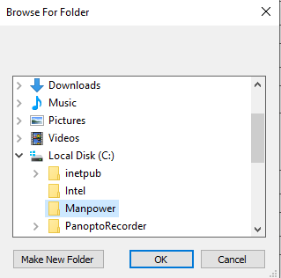
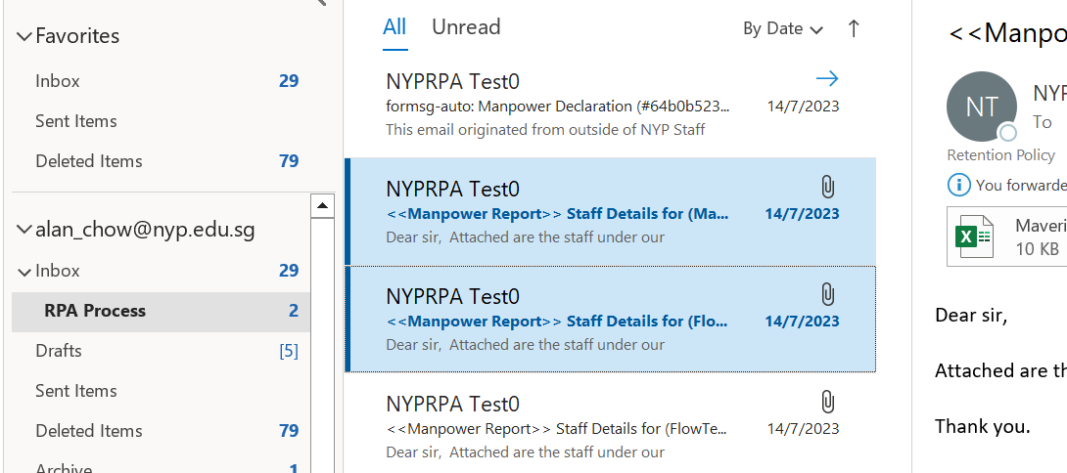
Go to Local C: → Make New Folder→
Manpower→ OK
Load the 2 emails into you outlook inbox

Slide 39
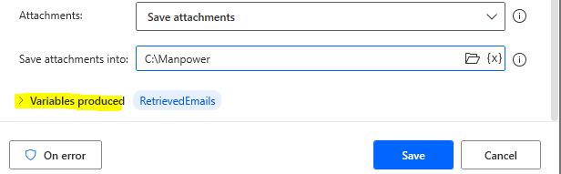

Notice that the Variable produced is where the emails will be stored:
RetrievedEmails
To run, click on the run button

Slide 40


The 2 attachments are downloaded into the Manpower Folder in C drive.
Out of the 4 unread messages, you will notice 2 of them for Manpower Report is now marked as read.

Slide 41
WHAT ARE VARIABLES?
Notice that the Variable produced is where the emails will be stored:
RetrievedEmails
An Outlook variable will be created. It will help reference to the Outlook.

Slide 42

What values can M be? What values can C be? What values can E be?

Slide 43

Variables!
E, m and c are all variables
They holds numbers/values
that can be used in an
expression.

Slide 44

a = 5 + 5
a is a variable.
It stores the value 10.
b = “Squid Game”
b is a variable.
It stores the value “Squid Game”

Slide 45


Important vocabulary
Variables: are placeholders used to store information to be referenced and manipulated. It is helpful to think of variables as containers that hold information.
Types of Variables:
Numbers: decimal points, whole numbers
String: a series of characters, can be alphanumeric and more
Boolean (True/false)
Lists
etc

Slide 46

Data variables needed
Can you identify?
What are the variables needed for ATM?

Slide 47
Data variables needed
Pin Number – Number
Withdrawal Amount
List of denominations amounts
Account number
Card number

Slide 48
Retrieve all emails with the <<Manpower Report>> and download attachments
Read excel files and add to google form
Reply to emails
Our workflow for the retrieveEmail application
Next step ➔ to reply user

Slide 49



Now we need to reply the emails one by one.
Search “for” and drag the “For Each” action to the main flow.
To loop the emails, we choose RetrieveEmails as the variable to iterate.

Slide 50


Add your email address
Drag the response to Outlook mail action into the loop.
Here you can choose your actions.
For this instance, is to reply.
Enter a body such as to reply in a few working days etc.
Check your Sent Folder for the email sent.

Slide 51

Test Your RPA Time & Have Fun!
Send an email to your outlook with a subject <<manpower report>>
Run your RPA after you received the email.
See if you are replied with the RPA

Slide 52
PowerApps – Robotic Process Automation
Setup Outlook
UI Automation & Email Automation
Data Entry Automation
Data Extraction from FormSG email

Slide 53
Retrieve all emails with the <<Manpower Report>> and download attachments
Read excel files and add to google form
Reply to emails
Our workflow for the retrieveEmail + replyEmail app
How many files are there? If it’s more than 1 files expected, then we should get all files from folder.

Slide 54
Create a new flow:
+New Flow→ Flow Name→ Create
readExcel
readExcel

Slide 55





Change to *xlsx
Search and drag Get files in folder action to the flow.
Now that you have multiple files in a list, what should you do to access them?
Like list of emails, let’s use a For Each Loop!!

Slide 56



As our files from the folder is stored in the Files variable, choose Files here.
Search and drag For Each action to the flow.
Notice I change the variable name to excelFile. This allows us to understand the flow better.
The action is created. Now we need to open each of the excel file.

Slide 57




Choose “and open the following document”
Remember, we are trying to open the current file in the loops from the folder
Since we stored the current file in this excelFile variable, let’s select it from here
Search and drag Launch Excel action to the FOR EACH flow.
excelInstance is where the data is at currently.
Notes:
The Launch Excel action is inside the FOR EACH FLOW. This means if there are multiple files, each files is opened ONE BY ONE and PROCESSED them
After launching, let’s read the data!

Slide 58

In previous step, we added the instance of the excel file to ExcelInstance. Choose that variable here.
We want to read all the available values
Search and drag Read from Excel Worksheet action to the FOR EACH flow.
Set first line of range to be header.

Slide 59


If we need to key in all the values into the form at https://tinyurl.com/ManpowerFormTest , what are the things we need?
Now, we can finally open the browser for every record and fill up the google form.
ExcelData is a table with many rows. So we need to again loop through the datatable with
FOR EACH
In programming, we call this nested Loop

Slide 60
The things we need in our For Loop
1) The correct RPA UI Automation of keying in the values into the website for 1 set of value first
2) Dynamically change the values that we need to key into the website
E.g using variables like %row[‘name’]%
3) The repeated steps of launching and closing the chrome and clicking the buttons within the form

Slide 61



https://tinyurl.com/ManpowerFormTest
Type in the URL here in as Initial URL
You can change the window state to Maximized.
Search and drag Launch new Microsoft Edge action to the FOR EACH flow.

Slide 62

To start Form Automation, begin by opening the Form in Edge browser
The record button allows you to record every step in filling up the form.

Slide 63

After you start recording, begin click each step and texting in each field.
The red colour boxes shows the control you are trying to automate.
You can choose to use any test data first.
chrome
You can pause anytime by using the pause button. You can also remove any of the steps if it is incorrect.
Continue until all the fields are filled up

Slide 64


After you are done with the recording, you can see the generated actions.
Double click the first Populate text. This is for name.
Type %row[‘Name’]%
Name is the column name in the excel file.

Slide 65



Monthly
After changing the values, we will see something similar

Slide 66

Now, do the same for ALL of the Populate text field on web page actions. Keep in mind the value that should be in the text box.
DataFields | Control
Name | Populate Text
Status | Populate Text
Nationality | Populate Text
Role | Populate Text
DOB | Populate Text
Contact Number | Populate Text
Gender | Populate Text
Length of Contract (Mths) | Populate Text
Monthly Salary | Populate Text
Monthly Allowrance | Populate Text
Add a close web browser button after the clicking of submit button.
After you are done, click run to see the bot in action.

Slide 67


Sometimes our Screen has different resolution and may affect UI automation
➔ How? We can consider maximizing the browser screen
Select by Windows instance/handle
2) Then select the browser instance
3) Set to maximized screen

Slide 68
PowerApps – Robotic Process Automation
Setup Outlook
Email Automation
Accessing excel rows and enter data into form
Extracting form data from FormSG email

Slide 69


Now we will want to access these 2 emails form the Form SG created via this URL:
https://form.gov.sg/64b0b288b0717e00128f3768
Whenever an entry is entered into the form, an formsg email is sent to the relevant email address of the form owner.
The 2 sample emails are results from the formSG form.

Slide 70


First we want access each email via a for loop. Can you do it yourself using the previous example?
Step 1: Launch Outlook
Step 2: Retrieve Email
Check Subject for form ID?
Step 3: For Each CurrentEmail in RetrievedEmail
Inside each email, we want to:
Extract the text
Append to Excel File

Slide 71

Hint1! - Launch Outlook
Search for Launch outlook and Use this

Slide 72


Hint2! - Retrieve Email
Use this
Type formsg-auto

Slide 73

Hint 3 Loop time!
Use this

Slide 74


To get the email body text, choose dynamic values→ CurrentItem and change to CurrentItem.Body.
Then save.
Set Variable allows us to extract out the email body text and separate them for every new Line.
Then, store it to an array, TextList.

Slide 75


When you test run the flow, the emailBodyText can be found in the variable output value:
Flow variables→ emailBodyText

Slide 76

In order to get each field, we need to spilt text:

Slide 77

In order to get each field, we need to spilt text:

Slide 78

Variable: emailBodyText.
Delimiter: Standard and New Line
We will be splitting the text line by line to produce a Textlist array.

Slide 79

Test run → click on Textlist and you will see the index of where your fields are. E.g. index 12 for Response ID value etc
Now we can extract row 10 and write to excel file.
Every field has an index.
Response ID - Row 12
Company name - Row 20
Industry - row 24
Point of contact email - row 32
Postal Code - row 36
Any Remarks - row 40

Slide 80

Add the Launch Excel action into the for loop.
Notes:
Inbox\RPA Process

Slide 81


And Open the Following Document
Browse to the excel file location that you store the formSG excel

Slide 82

This will get First free Column and row of the excel
This will set FirstColumn variable to 1 since Response ID is at column 1.
Write to excel file in the First Column and First Free Row
Close the excel file

Slide 83

Select ExcelInstance
Set this to the data to write (row 12 is response ID)

Slide 84


Challenge Ourselves!Lets write all the datapoints into the excel
Notes:
https://mymailnypedu-my.sharepoint.com/personal/alan_chow_nyp_edu_sg/_layouts/15/onedrive.aspx?id=%2Fpersonal%2Falan%5Fchow%5Fnyp%5Fedu%5Fsg%2FDocuments%2FRPA%5Ffolder&view=0

Slide 85
Challenge Ourselves! Can we make the code more efficient?
Shift the launch excel above the loop?
Notes:
https://mymailnypedu-my.sharepoint.com/personal/alan_chow_nyp_edu_sg/_layouts/15/onedrive.aspx?id=%2Fpersonal%2Falan%5Fchow%5Fnyp%5Fedu%5Fsg%2FDocuments%2FRPA%5Ffolder&view=0

Slide 86


Slide 87
Supplementary Slides
Steps to install Chrome Power Automate extension

Slide 88

Go to https://www.google.com/chrome/
Click on the Download Chrome

Slide 89


3) Click on “No” when the user account control pop out
4) Install without administrator privilege

Slide 90


5) Go to https://chrome.google.com/webstore/search
6) And search for powerautomate
7) Then click on add to Chrome

Slide 91

8) Go into the Chrome browser and type chrome://extensions
to check if the extension is installed
9 make sure it is enabled
Notes:
Install Power Automate browser extensions - Power Automate | Microsoft Learn

